Slide 1

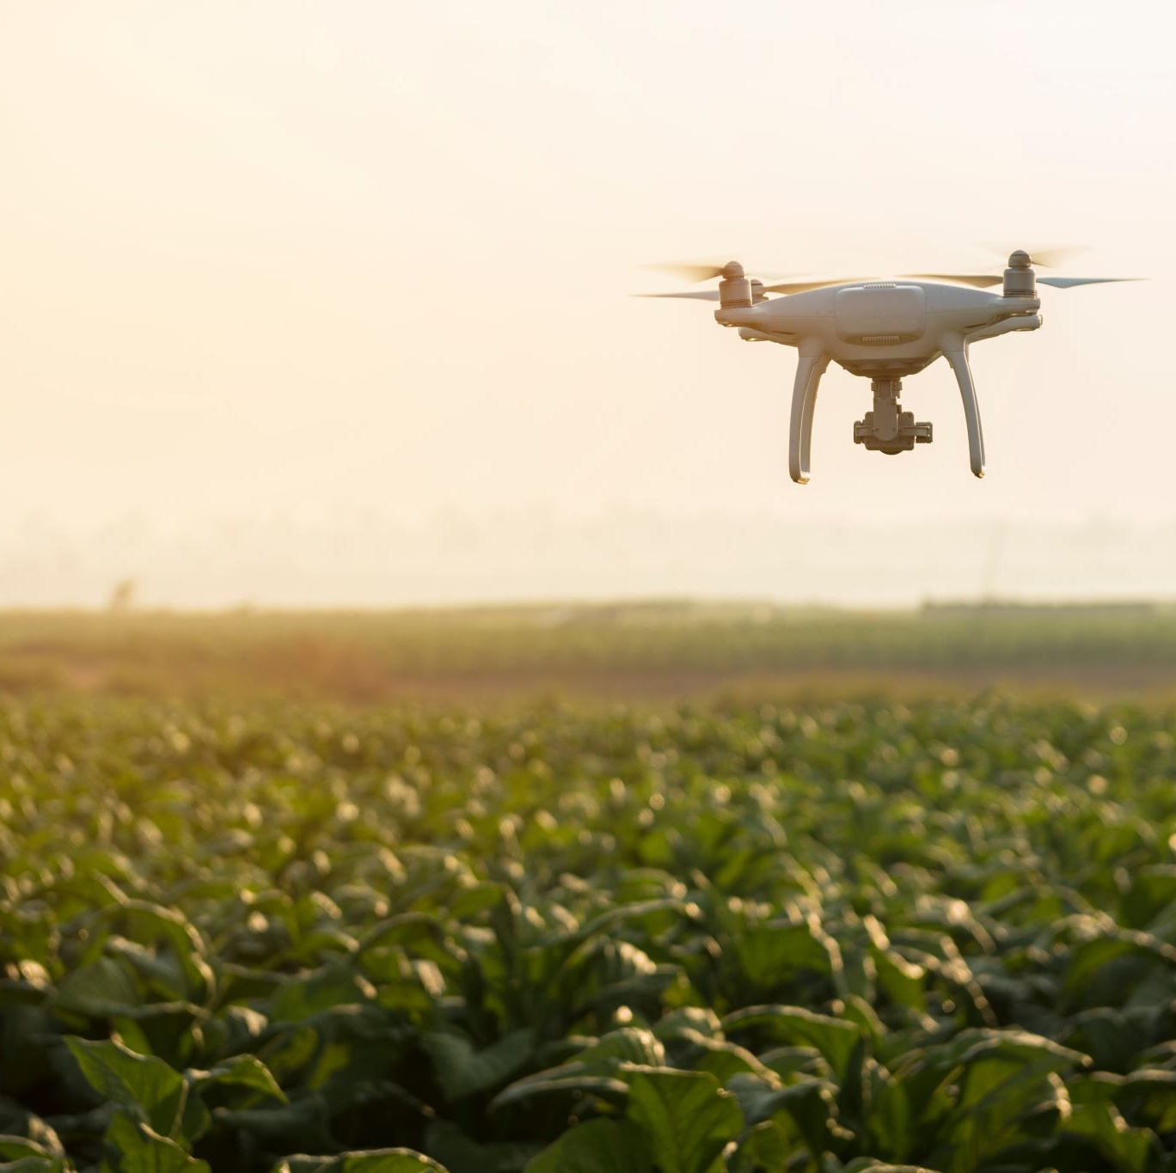
Modernizing Indian Agri Supply Chain Empowering Farmers through an Online Platform
Team B2: Members:
SRIHARI MADDINENI, Y20AIT507
BHARGAV KOMMINENI, Y20AIT453
POTTURI SRIRAM, Y20AIT490
THUMATI GOPI, Y20AIT511
Project Guide
Dr. B. Krishnaiah, Asst. Professor
Slide 1

Slide 2
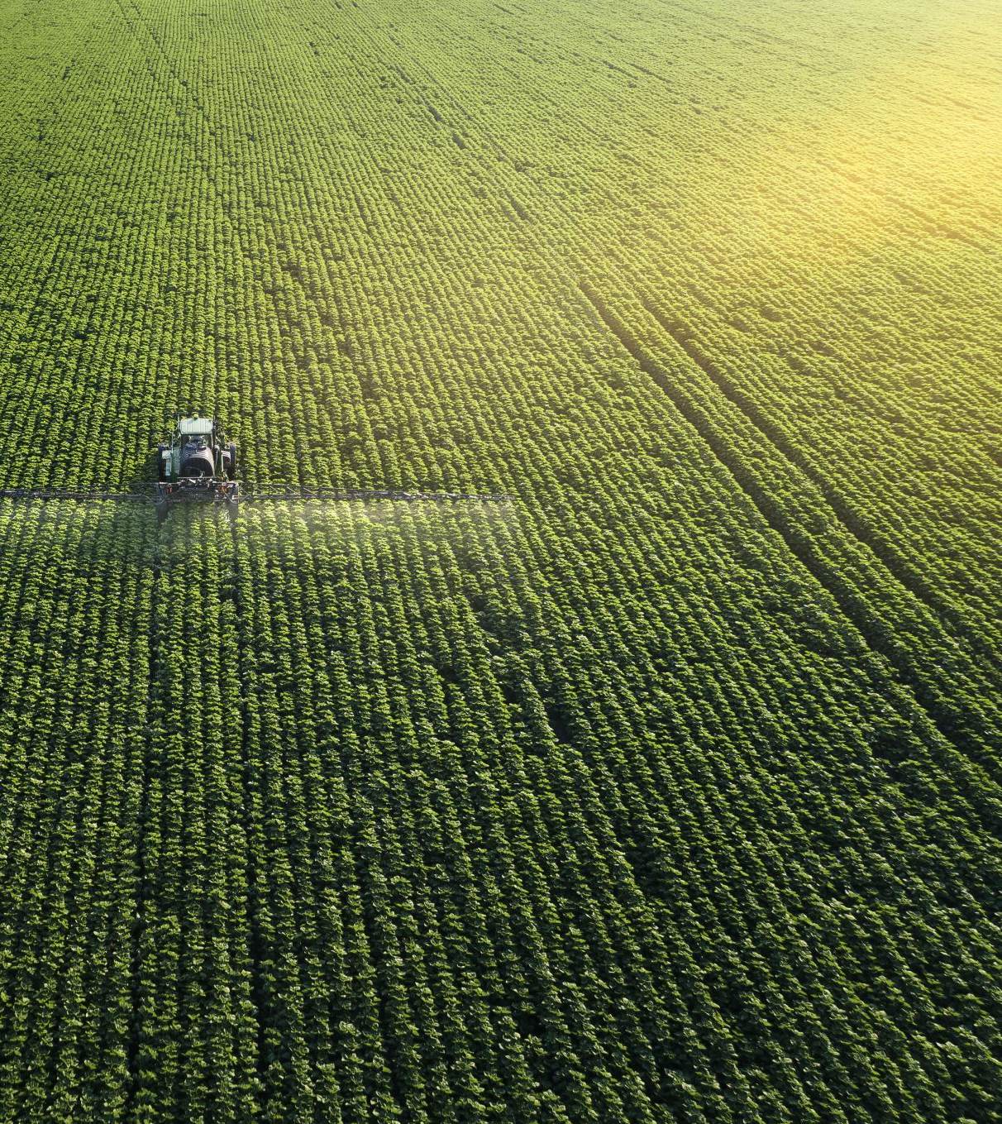
Abstract
The project involves creating an online platform named "KisanRaj" to modernize India's agricultural supply chain. This platform enables farmers to showcase their products, communicate directly with buyers, and negotiate prices efficiently. Buyers can access a diverse range of agricultural products and make offers seamlessly through filtering options. Leveraging technologies like React, Node.js, MongoDB, and Express.js, the portal ensures a user-friendly experience and secure transactions. Hosted on AWS servers, scalability and reliability are emphasized. Ultimately, the project aims to empower farmers and streamline the agricultural trade process for a sustainable future.

Slide 3
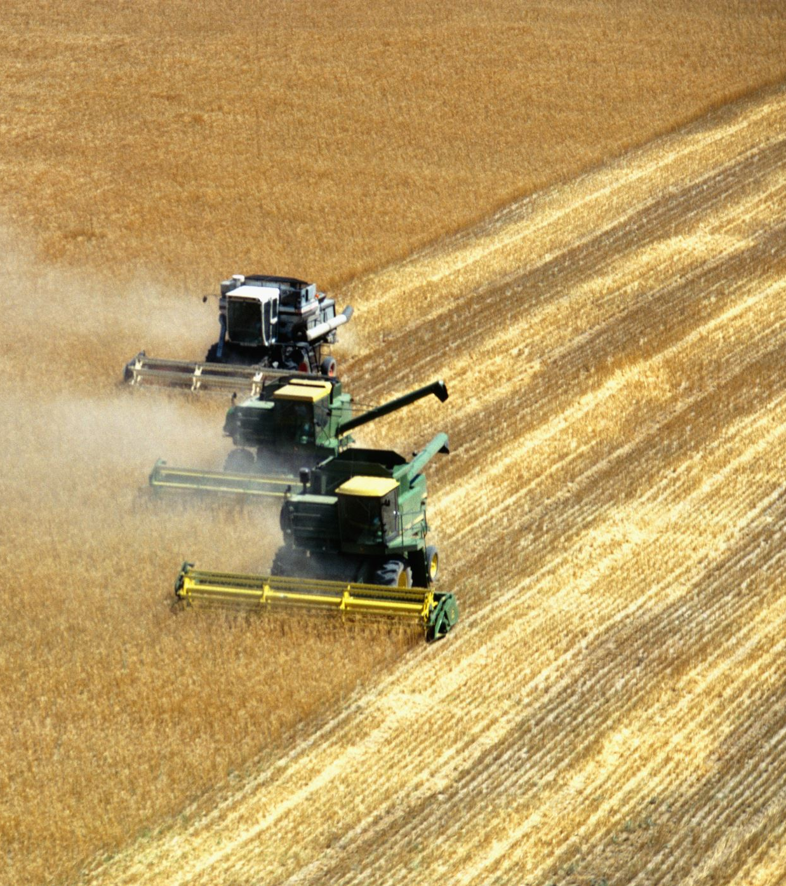
LITERATURE SURVEY
In the current era marked by rapid technological advancements, it has become increasingly essential for farmers and buyers alike to have access to a dependable platform for connecting and conducting transactions. This need is underscored by research findings indicating the significant impact of internet shopping on agricultural products [1], highlighting the crucial role of e-commerce in reshaping modern agriculture [2]. The integration of information technology has facilitated virtual interactions and knowledge sharing among stakeholders [3], which are vital for enhancing supply chain integration and improving overall efficiency in agricultural processes [4].

Slide 4
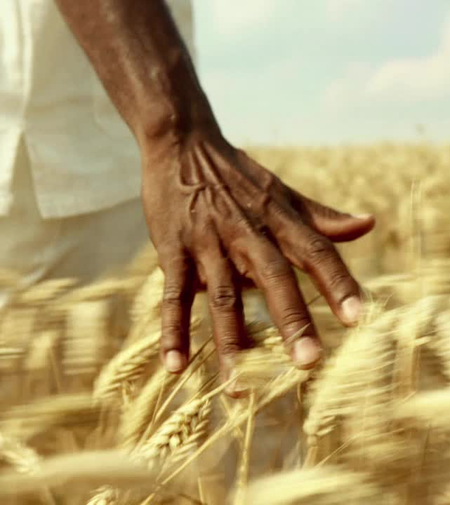
LITERATURE SURVEY
However, despite the potential benefits, the agricultural sector faces various challenges. For instance, issues related to rural freight transport necessitate the development of innovative solutions to ensure efficient transportation of goods [5]. In the context of Indian agriculture, efforts aimed at upliftment and effective risk management are crucial for sustainable growth [6]. Additionally, the implementation of e-learning initiatives can play a significant role in enhancing the skills and knowledge of agricultural workers, thereby contributing to overall sectoral development [7]. Moreover, leveraging Information and Communication Technologies (ICT) can further enhance the efficiency of horticultural supply chains [8], particularly in the context of e-commerce initiatives [9]. These technological advancements, driven by Industry Revolution 4.0, promise to revolutionize agricultural practices [10], enabling more sustainable production methods and increased efficiency [11].

Slide 5
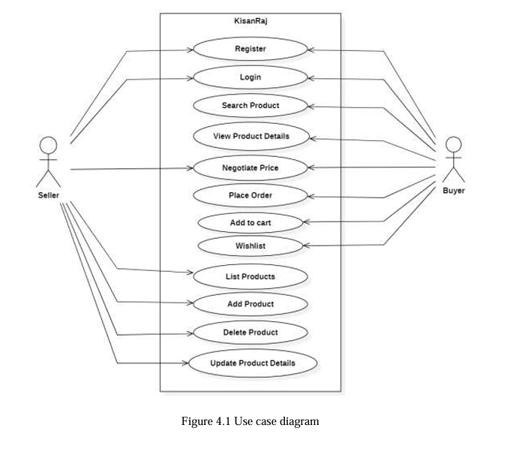
SYSTEM DESIGN and IMPLEMENTATION

Slide 6
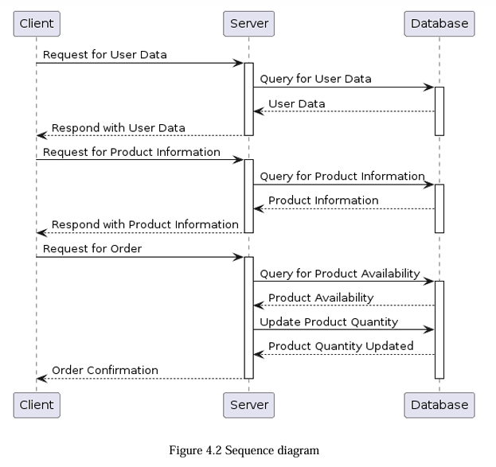
SYSTEM DESIGN and IMPLEMENTATION

Slide 7
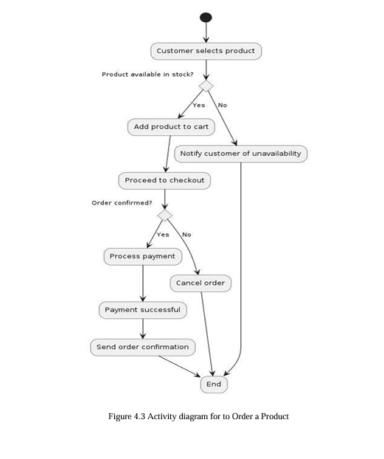
SYSTEM DESIGN and IMPLEMENTATION

Slide 8
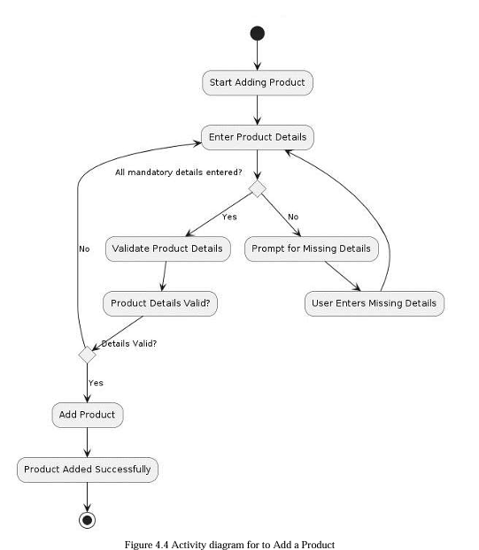
SYSTEM DESIGN and IMPLEMENTATION

Slide 9
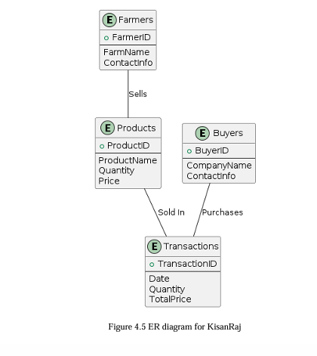
SYSTEM DESIGN and IMPLEMENTATION

Slide 10

Implementation
Open git hub and find the repository of KisanRajMvcChat under the url :
Kisanraj git repository
Use some code editor and open Terminal
VS Code is preferred
In the terminal, follow the commands:
In the root folder, >> npm i
Move to client folder >> cd client
Install packages >> npm i
Move back to root folder >> cd ..
Run project >> npm run dev

Slide 11
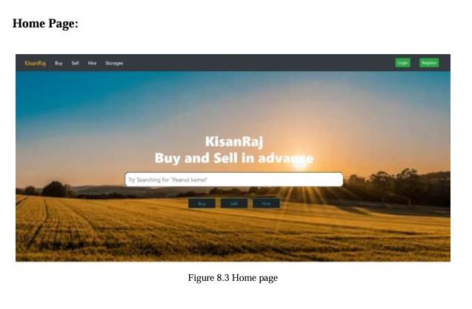
Result - Homepage

Slide 12
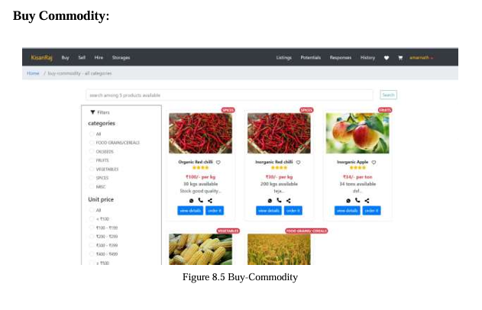
Result Buy commodity

Slide 13
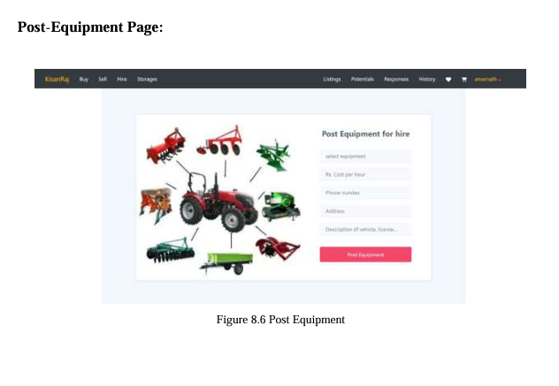
Result Post Equipment

Slide 14
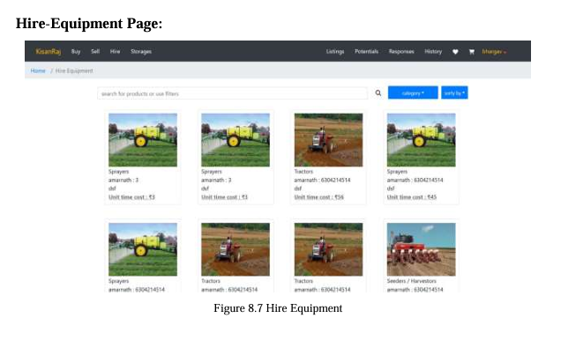
Result Hire Equipment

Slide 15

Conclusion
In conclusion, our project represents a significant leap forward in modernizing the Indian agricultural supply chain. By leveraging cutting-edge technologies and integrating key features such as direct communication, secure transactions, and connectivity with E-NAM, we are poised to revolutionize farmer-buyer interactions and enhance market access. Through our platform, farmers will have unprecedented opportunities to engage directly with buyers, negotiate fair prices, and expand their reach across different regions and states. Moreover, our commitment to sustainability and scalability ensures that our solution is not only effective in addressing current challenges but also adaptable and resilient in the face of future developments. By empowering farmers, fostering transparency, and promoting efficiency, our project contributes to building a more inclusive, resilient, and prosperous agricultural ecosystem in India

Slide 16

Future Scope
Enhanced Features: Continuously innovate and add new features to the platform, such as real-time market insights, weather forecasts, and agricultural advisory services, to provide comprehensive support to farmers.
Mobile App Development: Develop a mobile application for the platform to make it more accessible to farmers who may have limited access to desktop computers or internet connectivity.
Integration with IoT: Explore integration with Internet of Things (IoT) devices to enable smart monitoring of agricultural processes, such as soil moisture levels, crop health, and irrigation systems, for better decision-making.
Blockchain Integration: Implement blockchain technology to enhance transparency and traceability in agricultural transactions, ensuring fair pricing and reducing the risk of fraud.

Slide 17

REFERENCES
[1] Yi-chang, C., & Lee, H. (2020, January, The Effects of Website Content and Trust on Online Purchasing Intention of Agricultural Products. https://doi.org/10.2991/aebmr.k.200626.062
[2] Warlina, L., Siddiq, F., & Valentina, T. (2019, December 1). Designing website for online business in the agricultural sector. IOP Publishing, 1402(6), 066080-066080. https://doi.org/10.1088/1742-6596/1402/6/066080
[3] Ong, R J., Raof, R A A., Sudin, S., & Choong, K Y. (2021, February 1). A Review of Chatbot development for Dynamic Web-based Knowledge Management System (KMS) in Small Scale Agriculture. https://doi.org/10.1088/1742-6596/1755/1/012051
[4] http://www.manage.gov.in/studymaterial/scm/E.pdf Reading material on Supply chain management in agriculture.
[5] Kunaka, C 2011, ‘Logistics in Lagging Regions: Overcoming Local Barriers to Global Connectivity’, Washington DC, World Bank.

Slide 18

Thank you

